Slide 1
Image morphing
ASSIGNMENT 7
Group-12
AMAN RAJ VANAWAT – 16UCS030
DIVYESH MAHESHWARI – 16UCS063

Slide 2
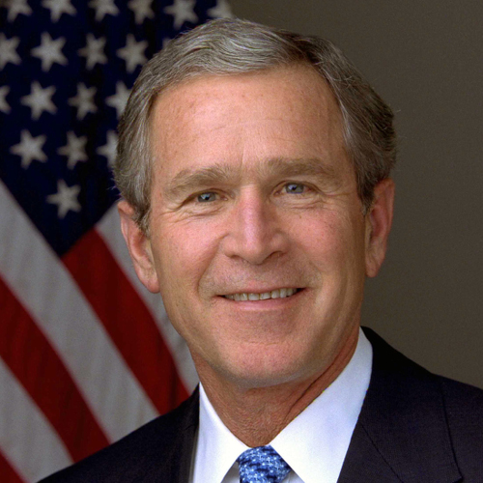
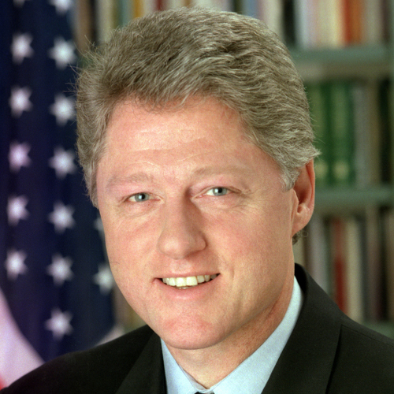
ASSIGNMENT
MORPH

Slide 3
PROCEDURE
STEP 1 - Select corresponding points (control points) in both the images and triangulate them.
STEP 2 - Linearly interpolate the coordinate values of control points and find out the affine coordinates of non-control points in the intermediate frame.
STEP 3 - Use these affine coordinates to find out the location of non-control points in the first and second images.
STEP 4 - Use color interpolation to assign color values to pixels in the intermediate frame.

Slide 4
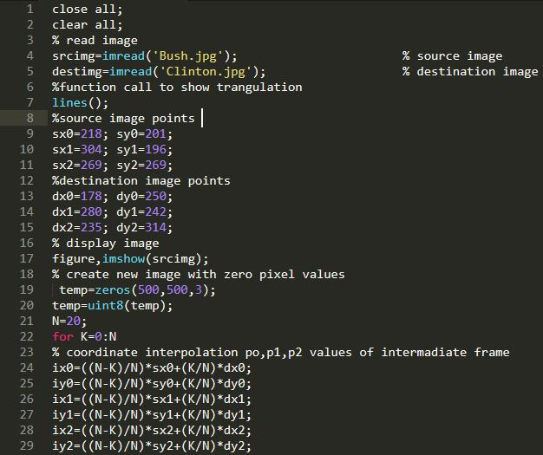
MATLAB CODE
Main()

Slide 5
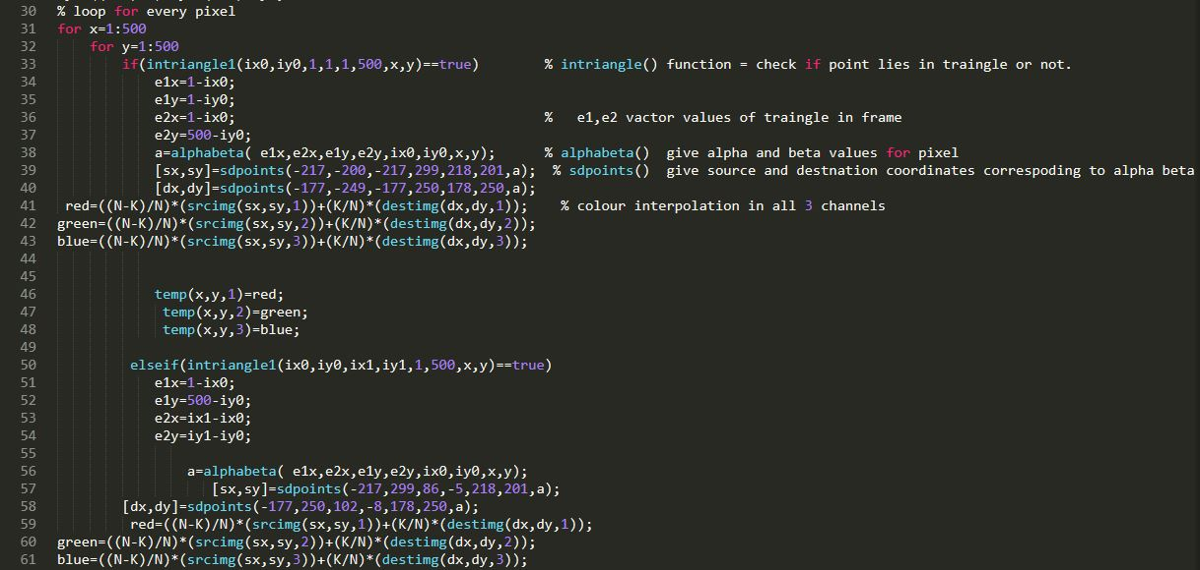

Slide 6
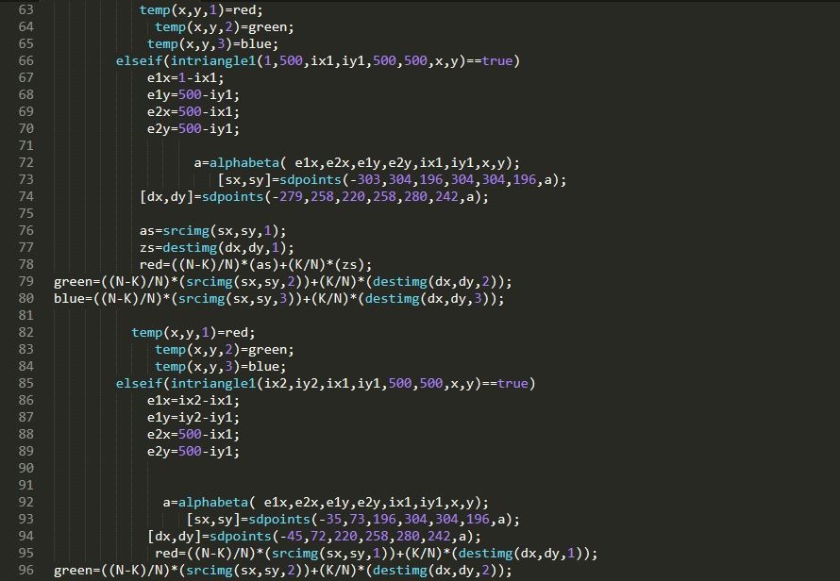

Slide 7
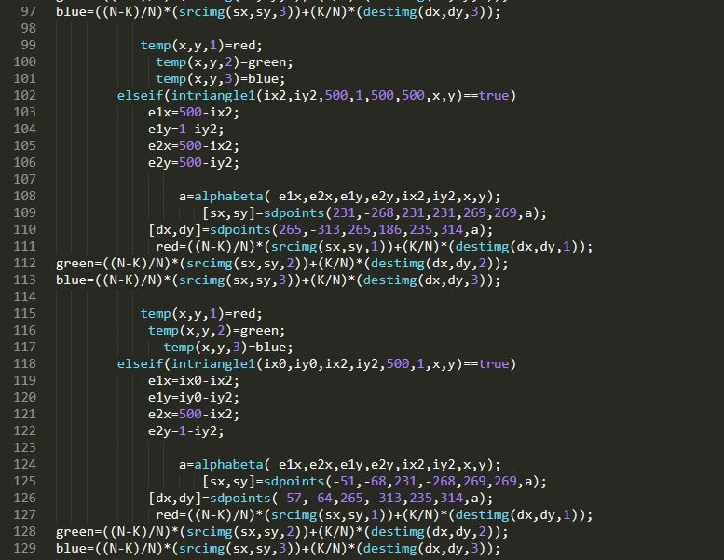

Slide 8
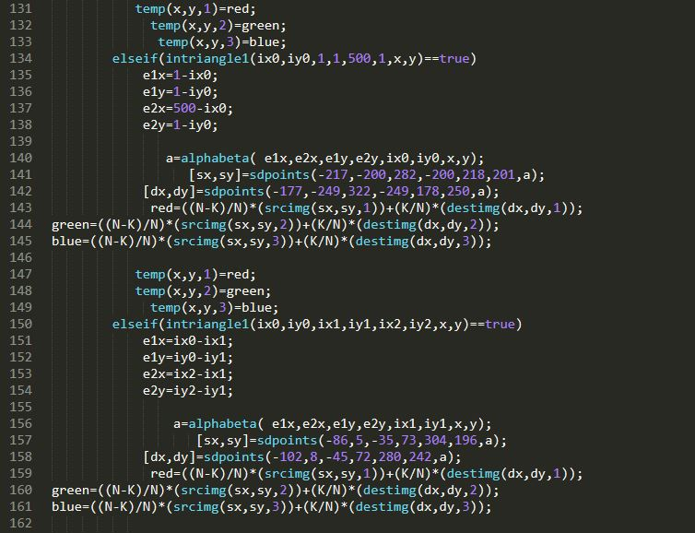

Slide 9
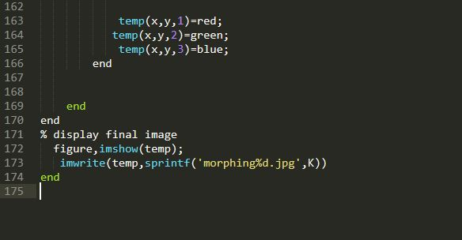

Slide 10
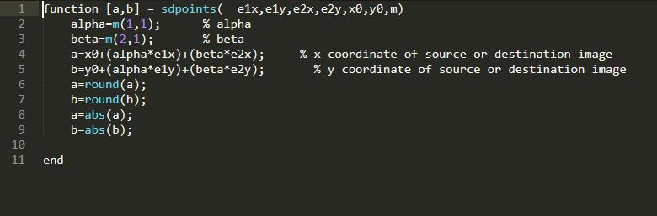
Functions
function sdpoints()

Slide 11
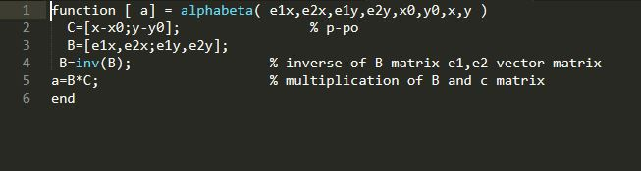
function alphabeta()

Slide 12
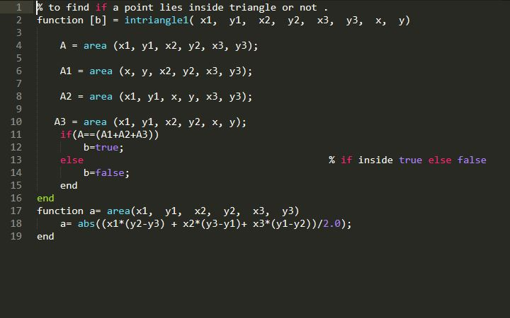
function intriangle1()

Slide 13
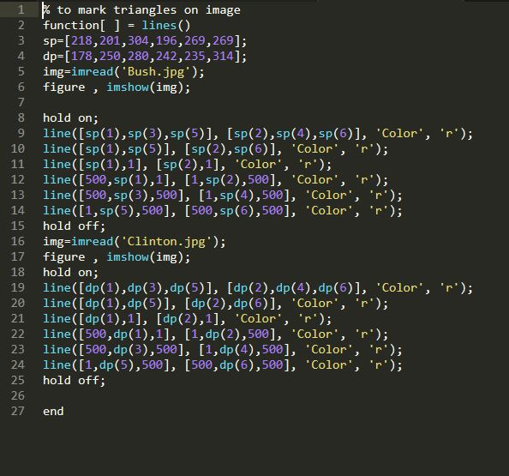
function lines()

Slide 14
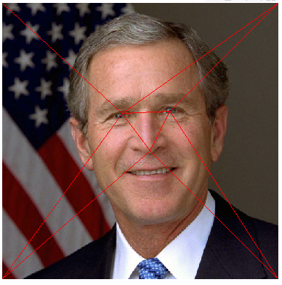
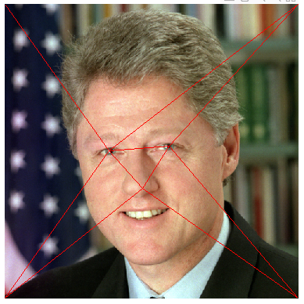
TRIANGULATION OF IMAGES

Slide 15

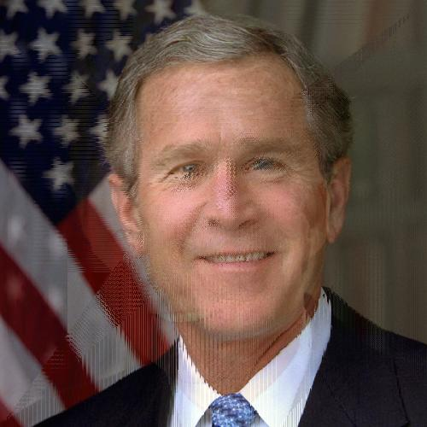
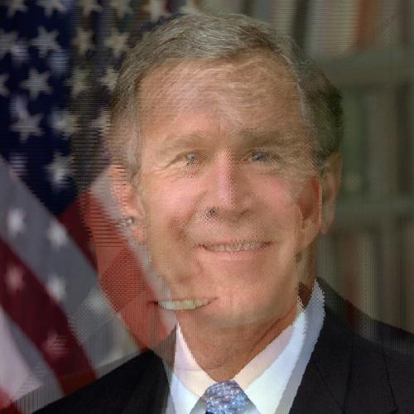

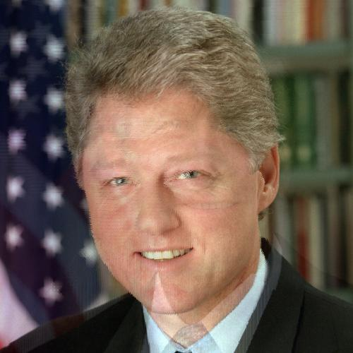
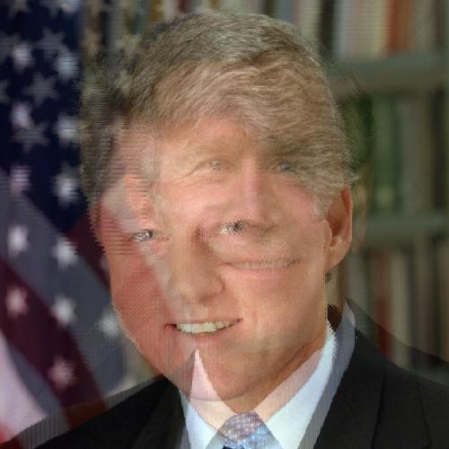
INTERMEDIATE FRAMES
FRAME 0
FRAME 4
FRAME 8
FRAME 20
FRAME 16
FRAME 12

Slide 16

OUTPUT

Slide 17
THANK YOU

